Slide 1
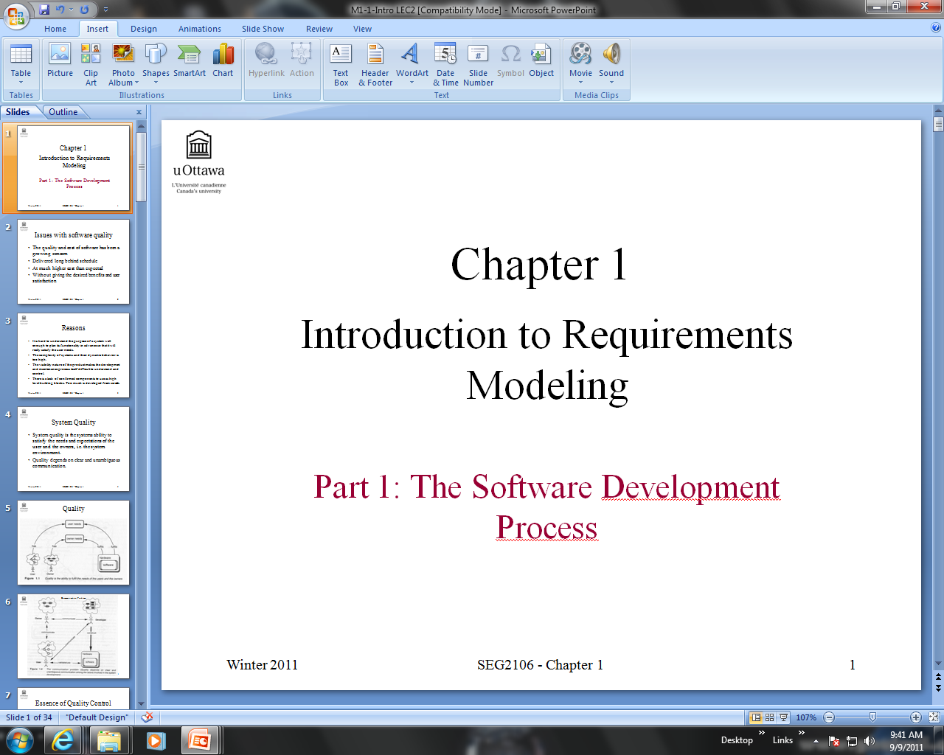
LECTURE 2
Engr Huma Ayub Vine

Slide 2
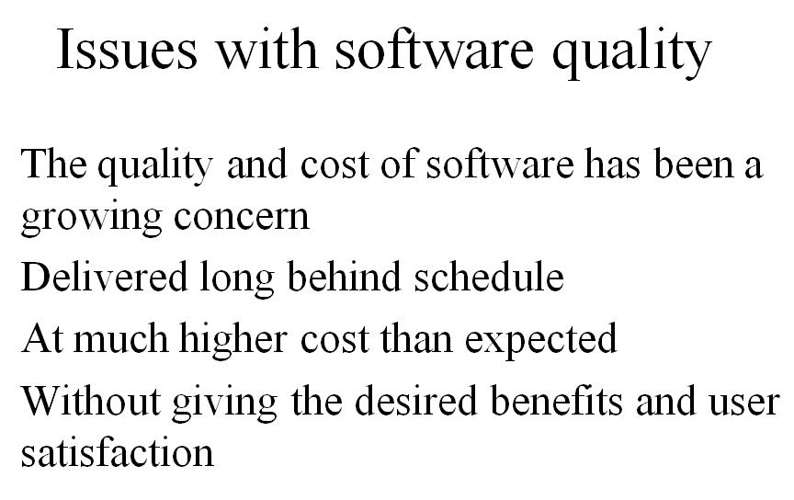

Slide 3
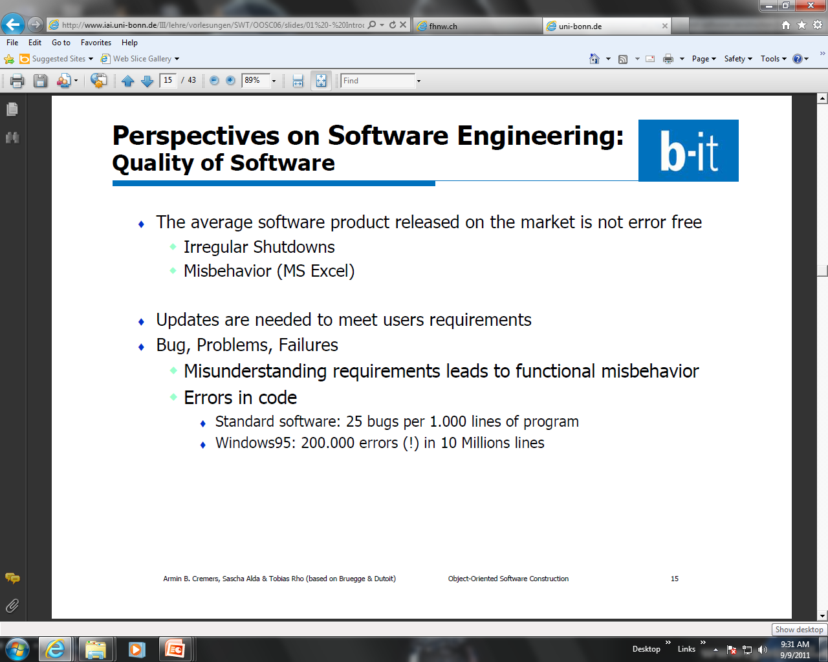
Perspectives on Software Engineering:
Quality of Software

Slide 4
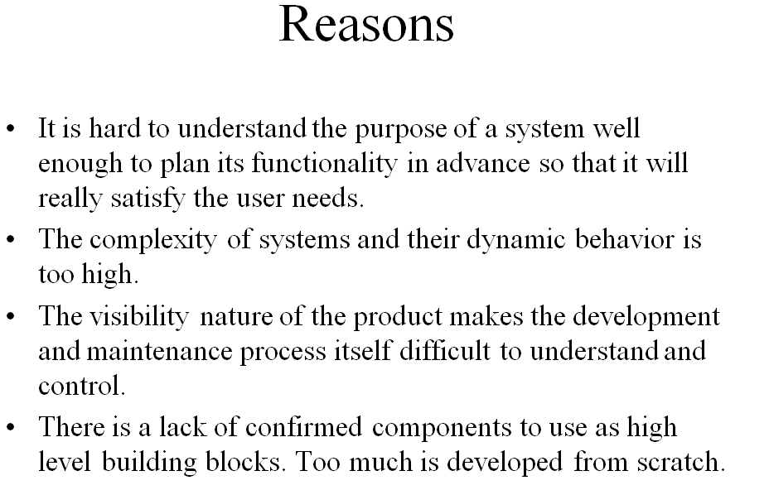

Slide 5
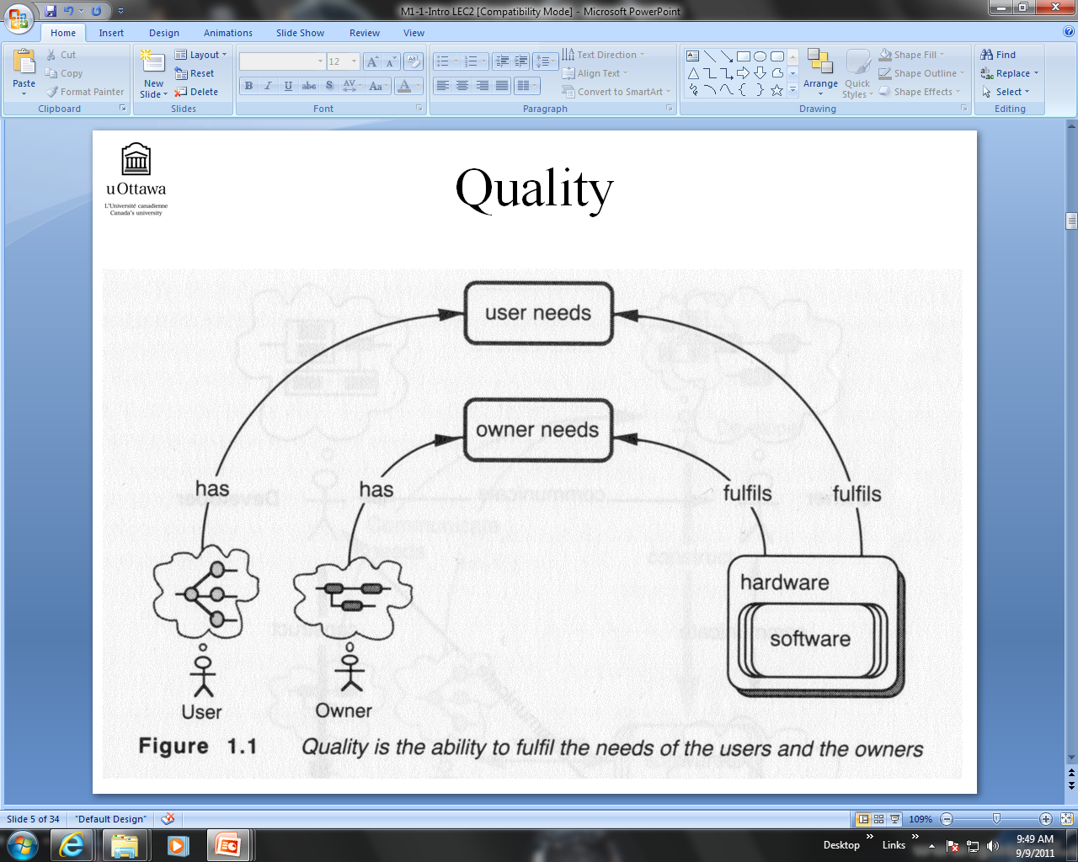

Slide 6
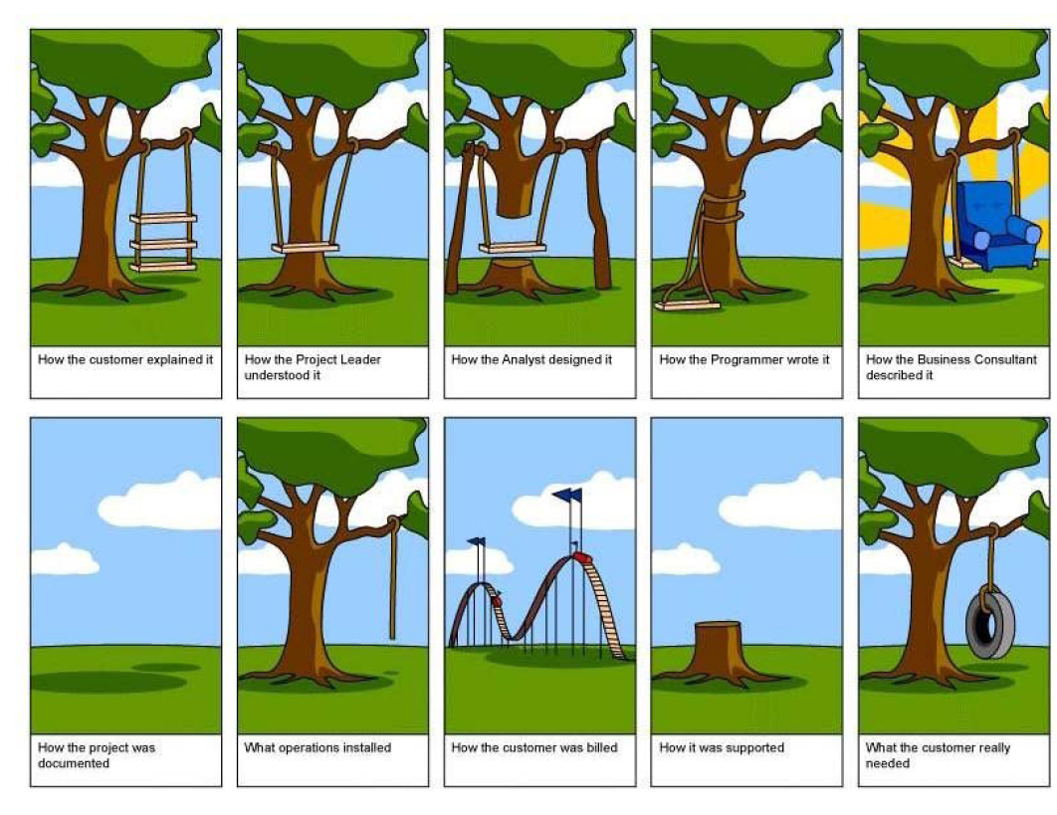
Communication Problem

Slide 7
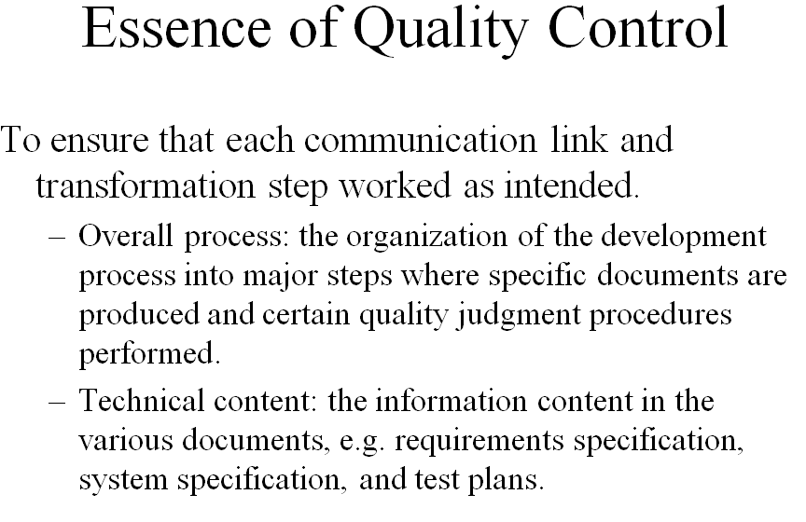

Slide 8
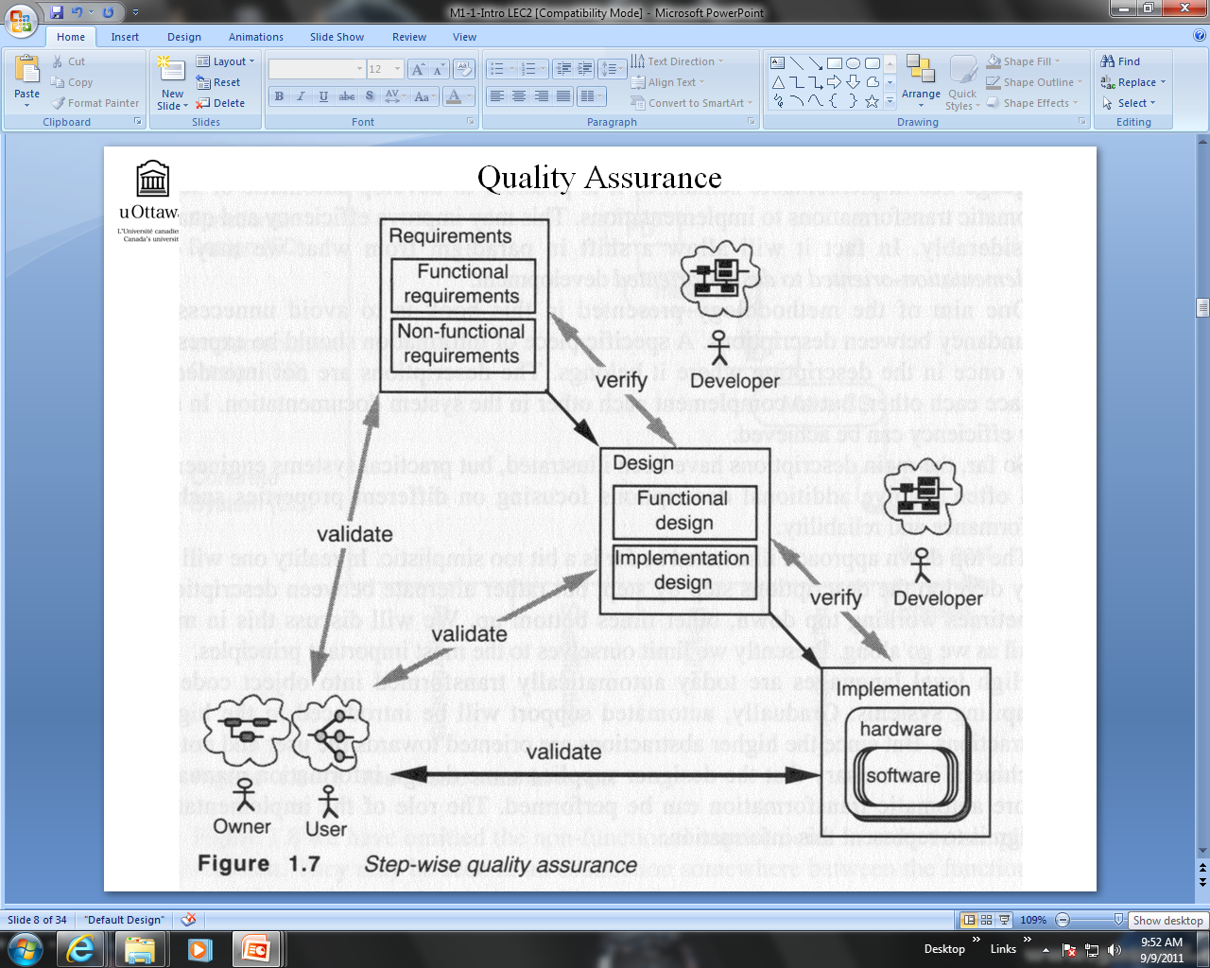

Slide 9
General Groupings of Things
There are two general groupings of things
  Structural things that define the conceptual and physical structures of an O-O system and are described by nouns.
  Behavioral things, the verbs that represent the behavior of the system and the states of the system before, during, and after the behaviors occur.

Slide 10
A Little Bit Review :
Object-Oriented Systems Analysis and Design
Object-oriented (o-o) techniques work well in situations where complicated systems are undergoing continuous maintenance, adaptation, and design.
The Unified Modeling Language (UML) is an industry standard for modeling object-oriented systems.

Slide 11
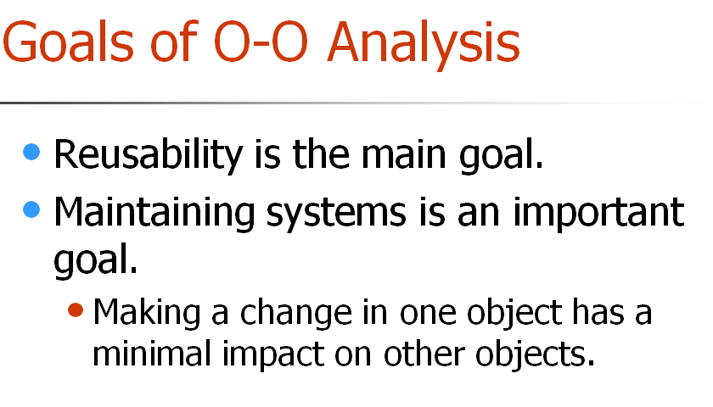

Slide 12
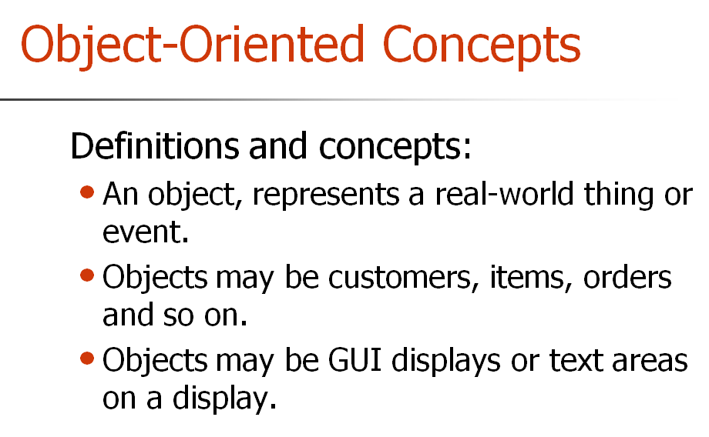

Slide 13
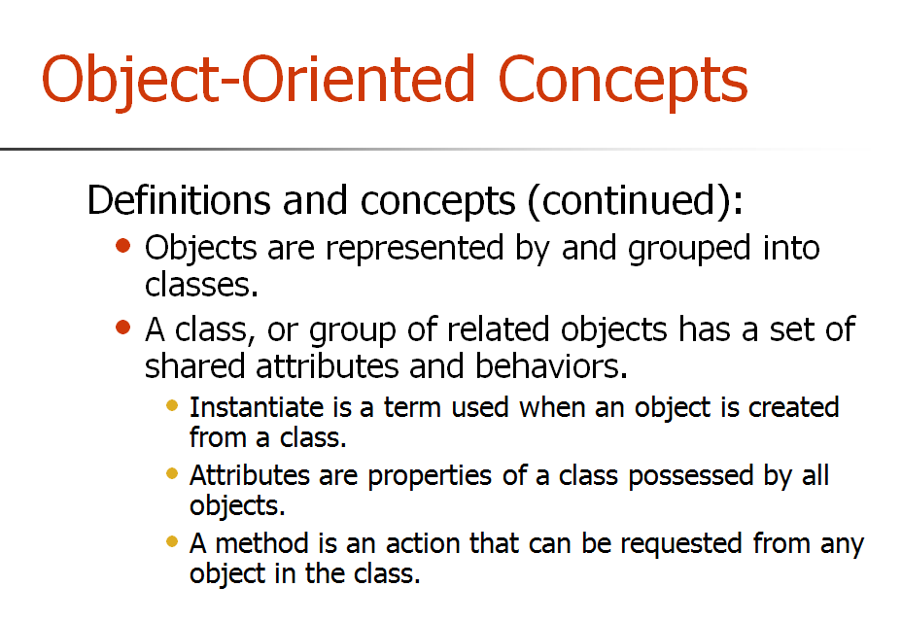

Slide 14
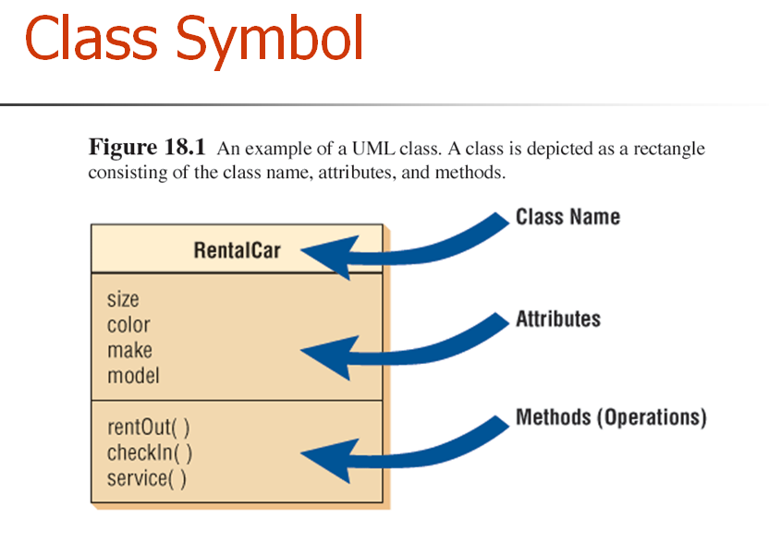

Slide 15
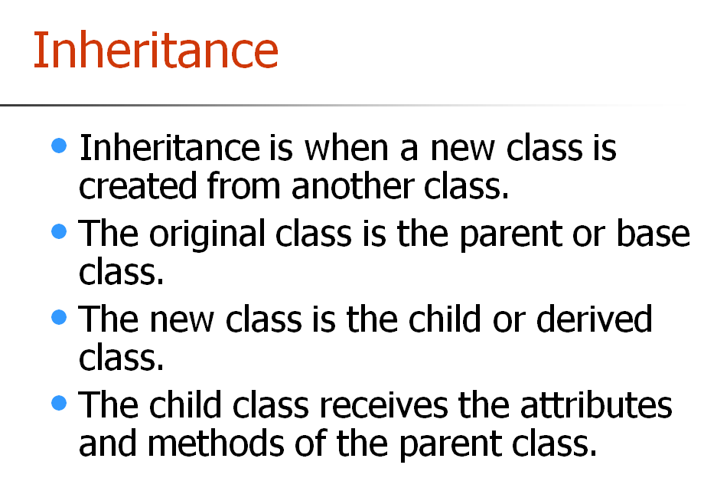

Slide 16
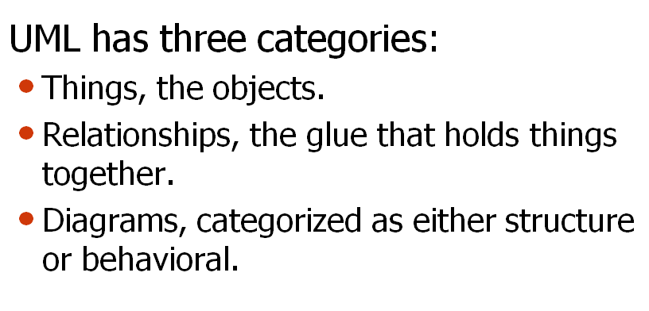
Practical Tool: UML

Slide 17
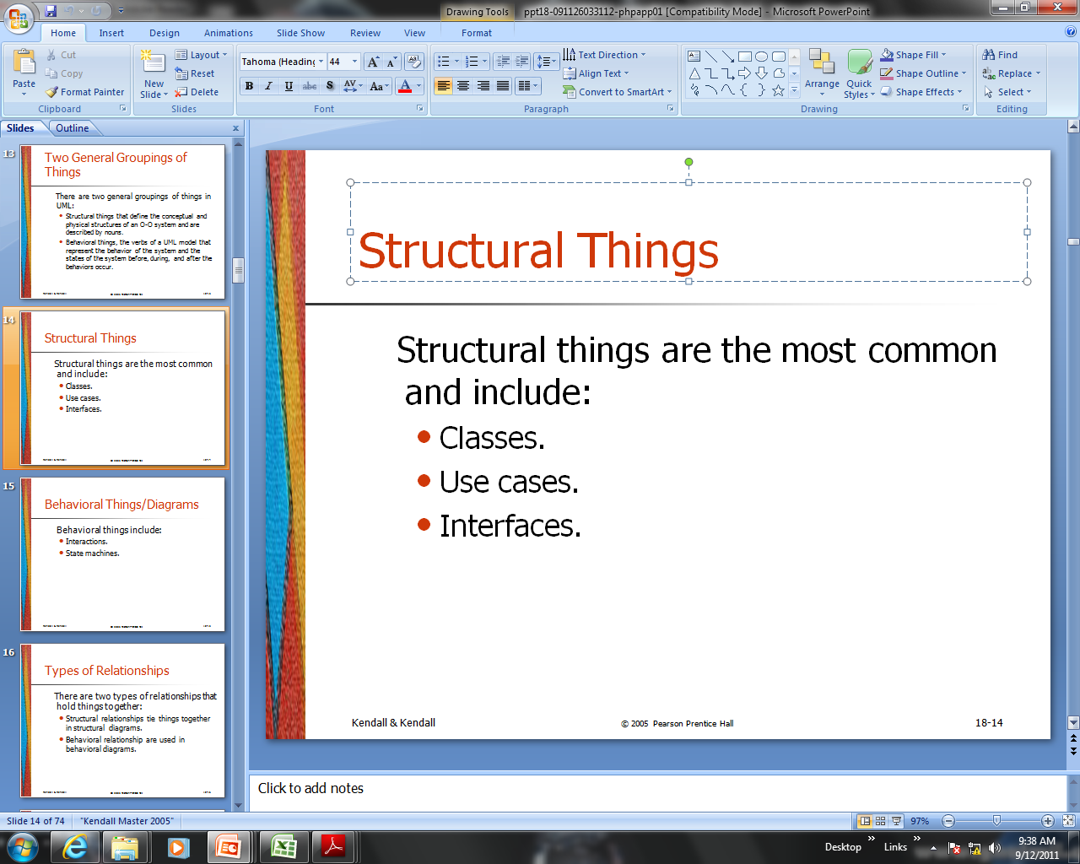

Slide 18
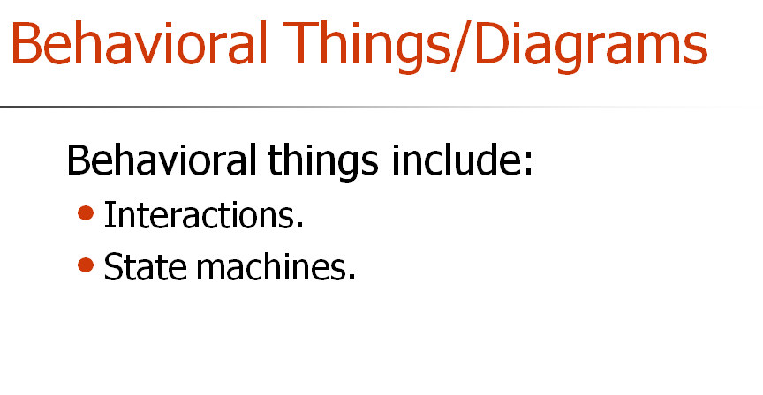
Sequence diagram and activity diagram

Slide 19
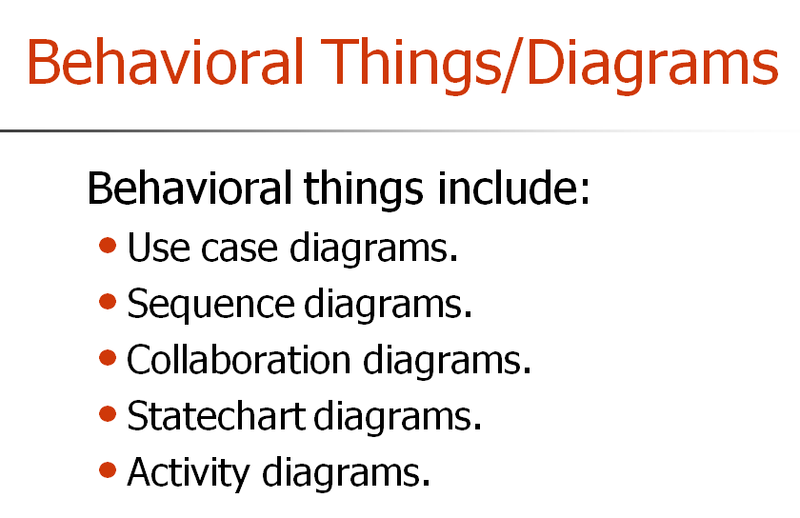

Slide 20
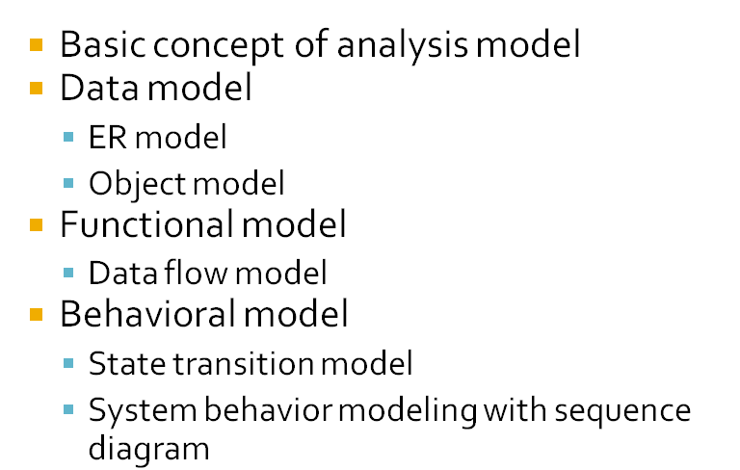
ANALYSIS MODEL REVISITED

Slide 21
Basic concept of Analysis Model
A Primarily step in Software construction
  To describe what the customer require by building a model using requirement elicited from customer
  To establish a basis for the creation of a software design
  To define a set of requirements that can be validated once the software is built, or validate software requirements using multiple dimensions thereby increasing probability of finding error

Slide 22
Model
What is a model?
  a model is a simplification of reality
Why do we model?
  we build models so that we can better understand the system we are developing
  we build models of complex systems because we cannot comprehend such a system in its entirety
  four aims to achieve
    help us to visualize a system
    permit us to specify the structure/behavior of a system
    give us a template that guides us in constructing systems
    document the decisions we have made

Slide 23
Analysis Model - UML
Function
Class diagram
Object diagram
Use case diagram
Activity diagram
Object
Data
Behavior
State-chart diagram
Interaction diagram
UML will be discussed in
later chapters

Slide 24
Relationship
Connectedness (join together)
A fact that must be remembered by the system and cannot or is not computed or derived
  Several instance of a relationship can exist
  Object/Entity can be related in many ways
own

Slide 25
Cardinality and Multiplicity
own
Automobile
Person
own
Make
Model
Body type
Price
Color
Birthday
Height
Weight
Expertise

Slide 27
Association: Multiplicity
Unspecified
Exactly one
Zero or more (many, unlimited
One or more
Zero or one
Specified range
Multiple, disjoint ranges
1
0..*
1..*
0..1
2..4
2, 4..6
Notes:
Specification of multiplicity flushes out business rules and assumptions. The lower bound is critical, as the lower bound is what determines whether or not the relationship is optional (e.g., a lower bound of 0 indicates that the relationship is optional).
Multiplicity is needed on both ends of a relationship, even if you can only navigate in one direction. Even though there is no need to navigate in that direction, the multiplicity still provides valuable business information. Sometimes navigation decisions are made for performance reasons, which may change over time. The multiplicity should reflect the requirements.
Navigation is discussed on later slides.
The use of ‘N’ instead of ‘*’ is Booch, not UML (e.g., the use of “0..N” and ‘N’ is not UML).

Slide 28
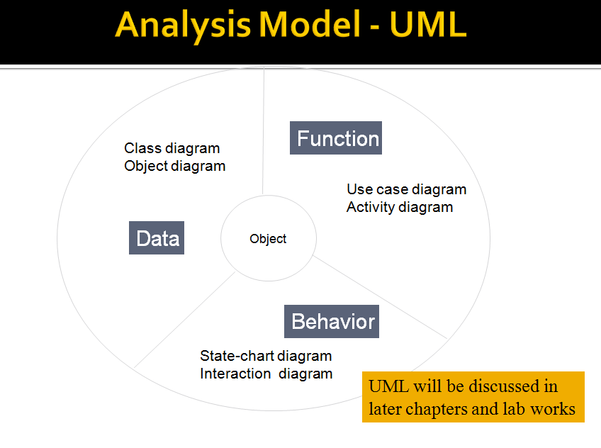

Slide 29
Object models
Object = entity + operations
Object models describe the system in terms of object classes
An object class is an abstraction over a set of objects with common
attributes and the services (operations) provided by each object
Various object models may be produced
  Inheritance models
  Aggregation models
  Interaction models

Slide 30
Asssociation and Aggregation
Association
• Is a Relationship between objects.
• Objects have independent lifecycles.
• There is no owner.
• Objects can create and delete independently.
Aggregation
Specialize form of Association.
• has-a relationship between objects
• Object have independent life-cycles
• Parent-Child relationship

Slide 31
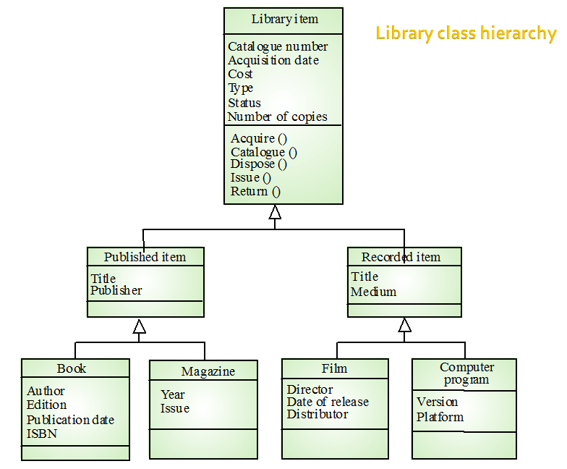

Slide 32
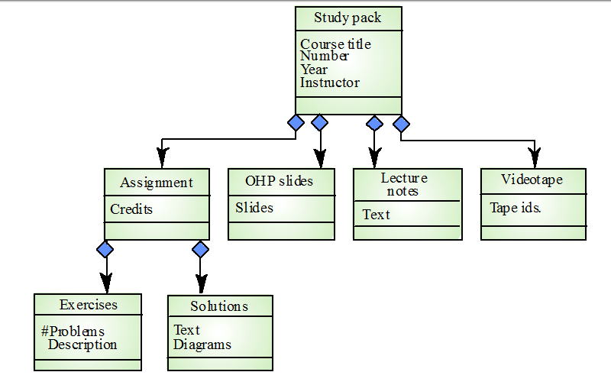
Object Aggregation

Slide 33
Functional Modeling: Data Flow Diagram
Every computer-based system is an
information transform ....
computer
based
system
input
output

Slide 34
Data Flow Diagramming
all icons must be labeled with meaningful names
the DFD evolves through a number of levels of detail
always begin with a context level diagram (also called level 0)
always show external entities at level 0
always label data flow arrows
do not represent procedural logic

Slide 35
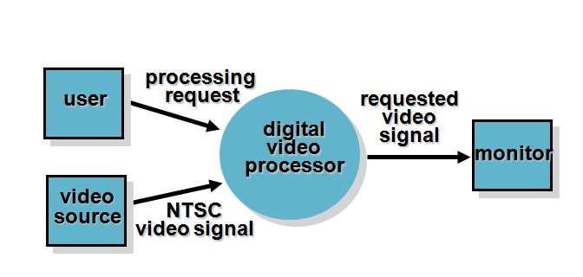
Level 0

Slide 36
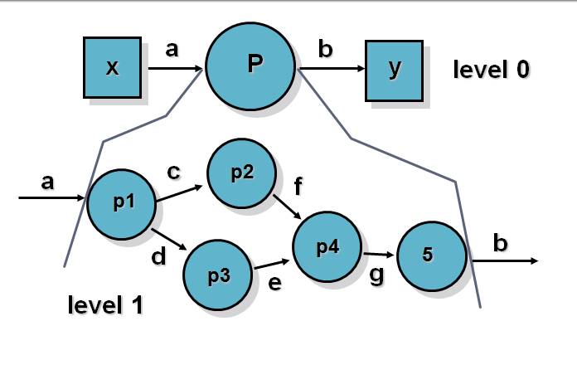
Level 1

Slide 37
Using PSPEC
Process Specification (PSPEC) can be used to specify the processing details implied by a process within a DFD
Check &
convert
pressure
PSPEC
If absolute tank pressure > max pressure
then
set above pressure to “true”;
else
set above pressure to “false”;
begin conversion algorithm x-01a;
compute converted pressure;
end
end if

Slide 38
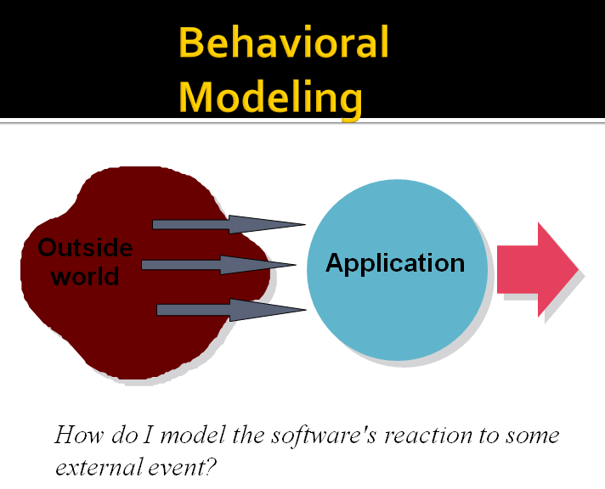

Slide 39
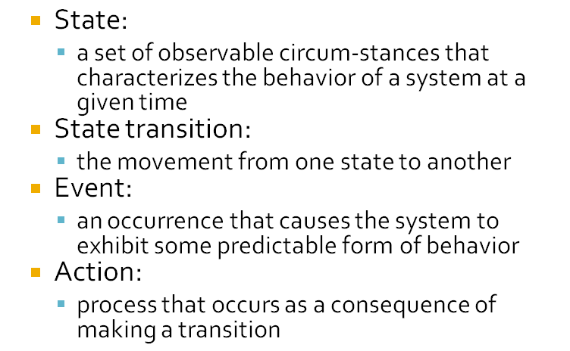
Basic Concept

Slide 40
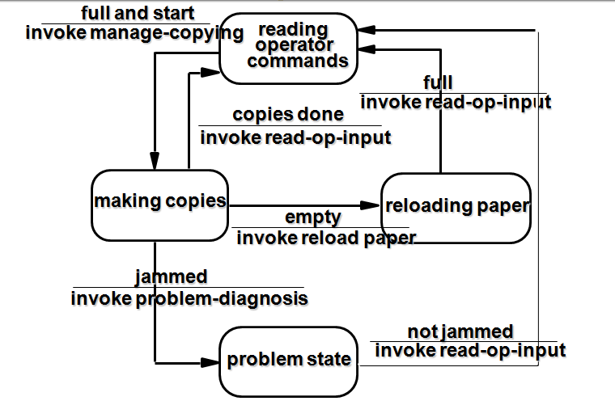
EXAMPLE

Slide 41
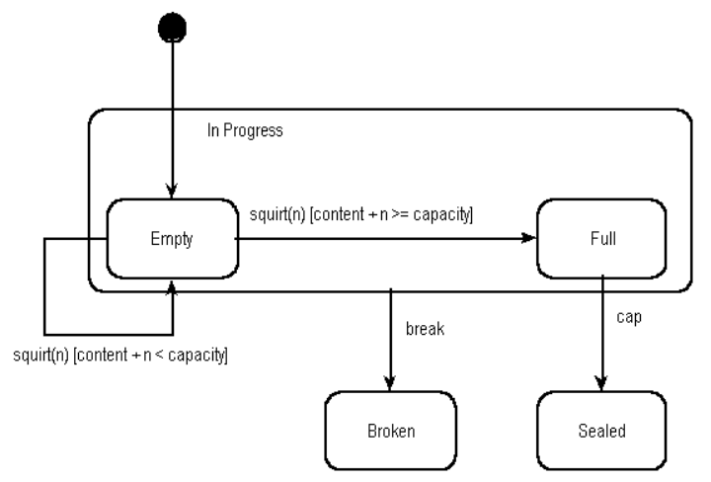
A Harel statechart

Slide 42
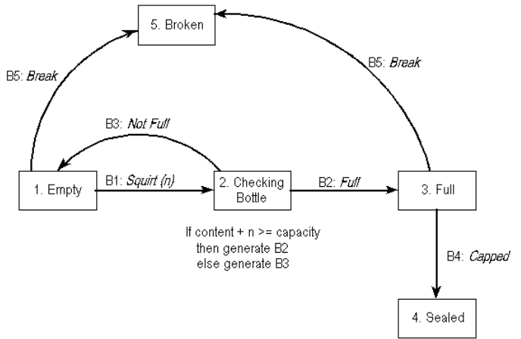
Moore model state diagram as used by Shlaer/Mellor. It is the equivalent to figure 1.

